Slide 1

JAVA OOP Constructor Overloading and Overriding
Lecturer: Jay A. Abaleta

Slide 2
What is constructor overloading in Java?
It is similar to methods you can also overload constructors example you can write more than constructor with different parameters.
And, based on the parameters we pass at the time of instantiation, respective constructor will be invoked.

Slide 3
Syntax:
modifiers class className
{
//Attributes
className(arguments) {
}
className(arguments) {
}
}

Slide 4
When do we need Constructor Overloading?
Sometimes there is a need of initializing an object in different ways.
This can be done using constructor overloading.

Slide 5
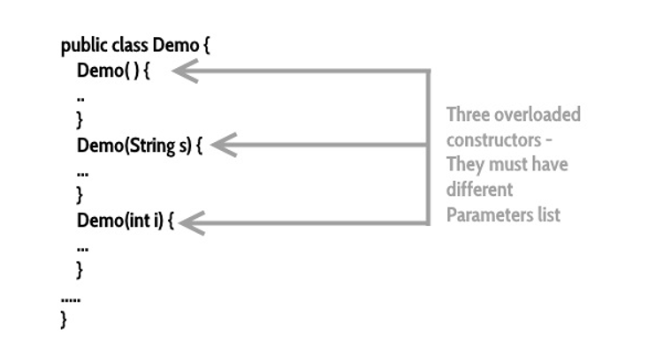
The Layout of Overloading Constructor

Slide 6

Using this() in Constructor Overloading
this() reference can be used during constructor overloading to call the default constructor implicitly from the parameterized constructor.

Slide 7
Program Example:
Requirements
Create Main Class and Sub Class
Create Overloading Constructor to your Sub Class
Use the this() reference

Slide 8
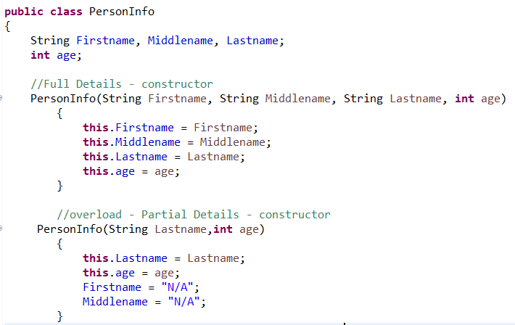
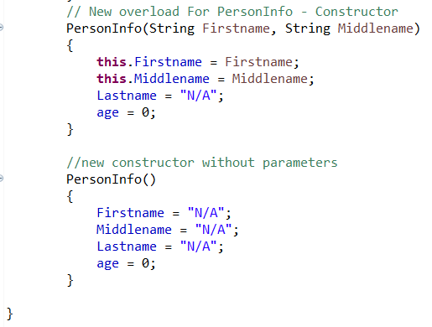
Sub Class (PersonInfo.java)

Slide 9
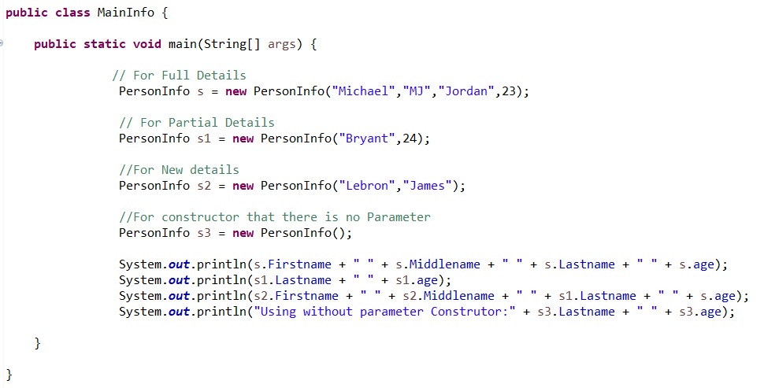
Main Class (MainInfo.java)

Slide 10
Java Method Overriding
Method overriding allows us to achieve run-time polymorphism and is used for writing specific definitions of a subclass method that is already defined in the superclass.

Slide 11
Usage of Java Method Overriding
Method overriding is used for achieving run-time polymorphism.
Method overriding is used for writing specific definition of a subclass method (this method is known as the overridden method).

Slide 12
What is Constructor in Java?
A constructor initializes an object when it is created. It has the same name as its class and is syntactically similar to a method. However, constructors have no explicit return type.

Slide 13
Syntax of Constructor
Example:
public class MyClass {
Int num;
MyClass() {
num = 100;
}
}
class ClassName
{
ClassName() {
}
}

Slide 14
Two types of constructors
1. No argument Constructors
As the name specifies the no argument constructors of Java does not accept any parameters instead, using these constructors the instance variables of a method will be initialized with fixed values for all objects.

Slide 15
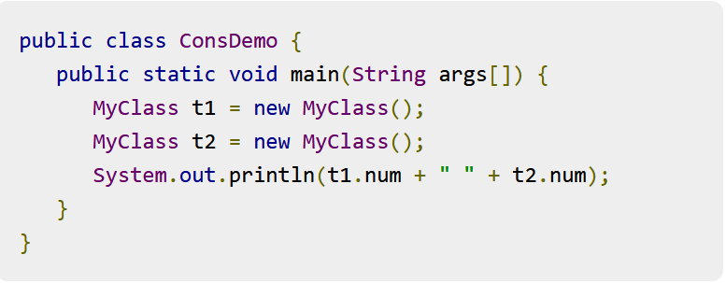
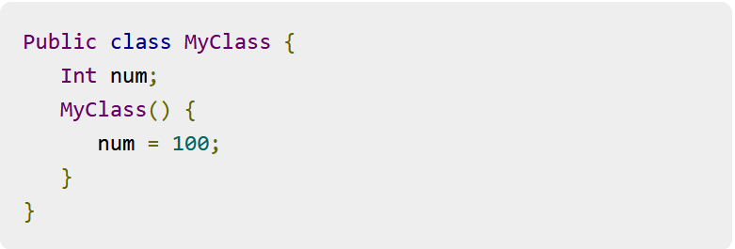
Example:

Slide 16

Two types of constructors
2. Parameterized Constructors
Most often, you will need a constructor that accepts one or more parameters. Parameters are added to a constructor in the same way that they are added to a method, just declare them inside the parentheses after the constructor's name.

Slide 17
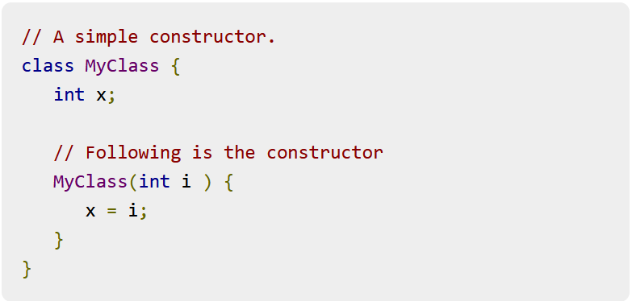
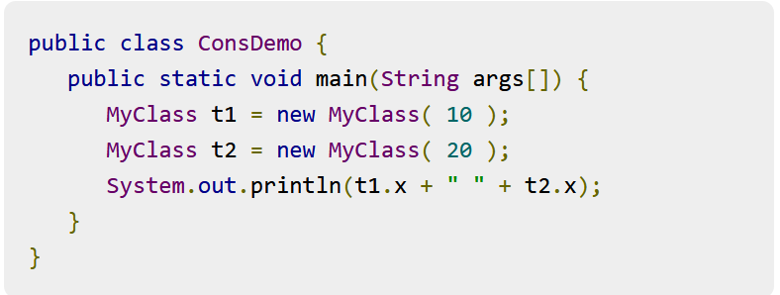
Example:

Slide 18

Overriding Constructor in Inheritance
The benefit of overriding is: ability to define a behavior that's specific to the subclass type, which means a subclass can implement a parent class method based on its requirement.
In object-oriented terms, overriding means to override the functionality of an existing method.

Slide 19
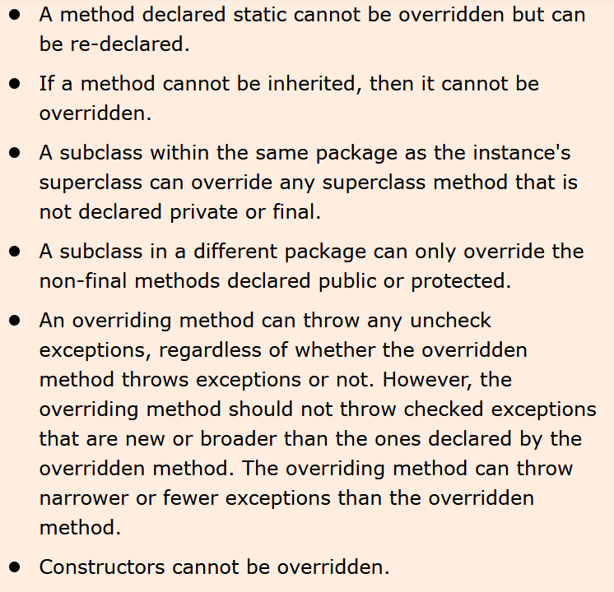
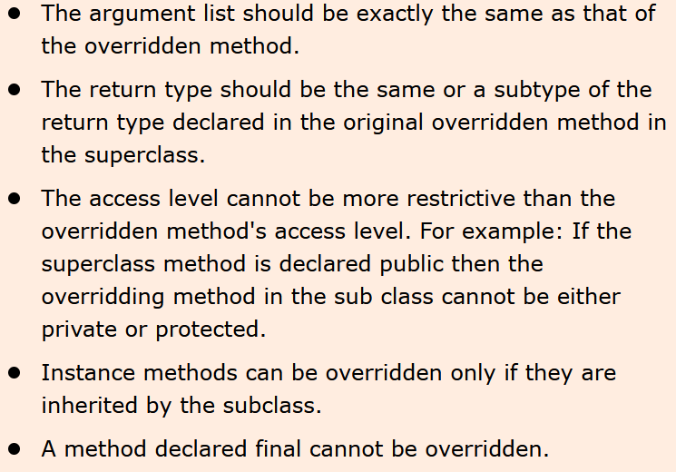
Rules for Method Overriding

Slide 20
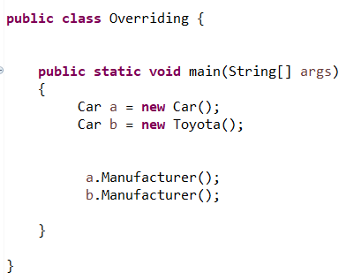
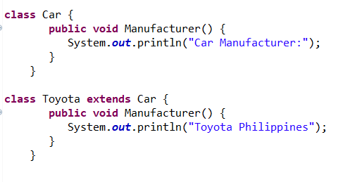
Overriding Example

